Slide 1
Computer vision portfolio-3

Slide 2
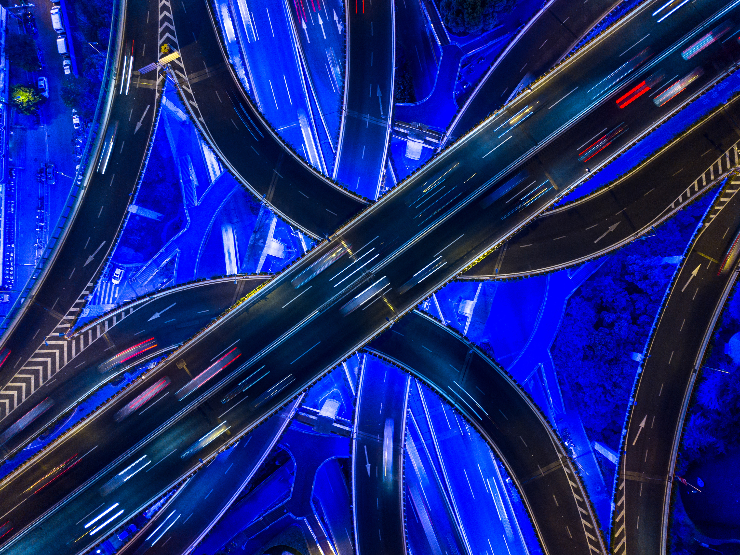
Part1: Implement and analyze a Variational Autoencoder on CelebA

Slide 3
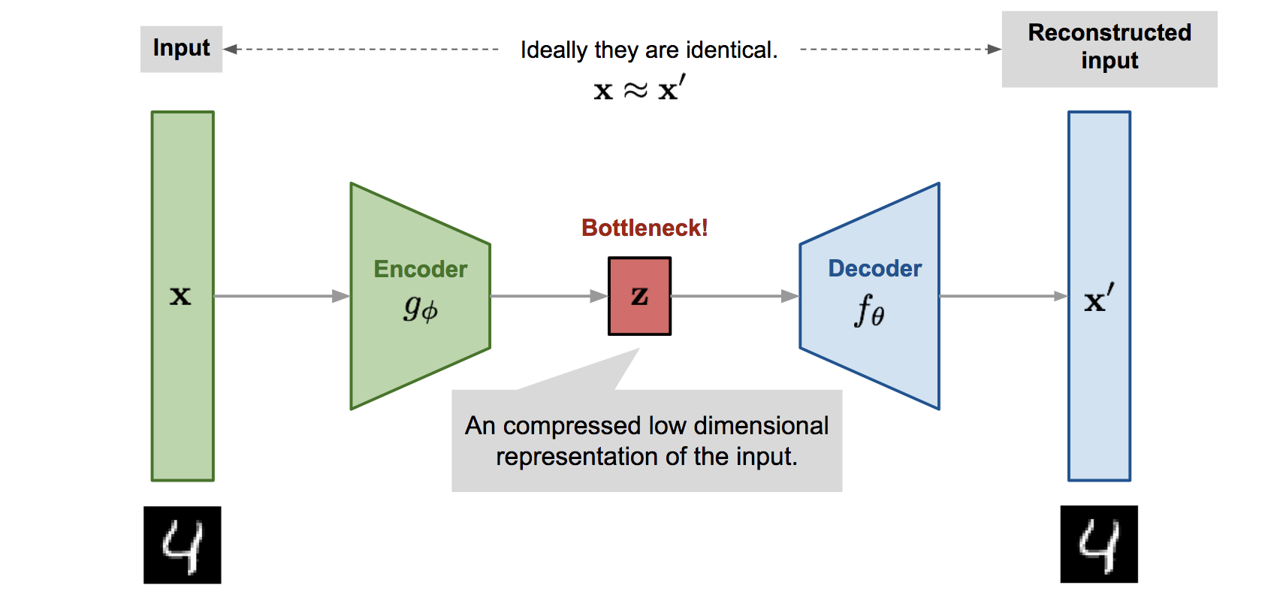
Variational autoencoders (vae)

Slide 4
Task 1: Build and train baseline VAE on CelebA with documentation Task 2: Latent space exploration via visualization, interpolation, and traversal Task 3: Implement β-VAE variant and compare reconstruction vs. disentanglement

Slide 5
Dataset: CelebA
Total Images: 202,599 celebrity face images
Resolution Used: 64×64 pixels (down sampled from 178×218)
Training Set: 170,000 images (84%)
Validation Set: 19,962 images (10%)
Test Set: 12,637 images (6%)

Slide 6
Training Pipeline
Batch Size: 64
Learning Rate: 1×10⁻³ (Adam optimizer)
Epochs: 40 (Baseline), 20 (β-VAE)
Reconstruction Loss: Binary Cross-Entropy (BCE)
KL Weight Factor: 5.0 (β=1 for baseline VAE)
Latent Dimension: 256
Epsilon: 1×10⁻⁵

Slide 7
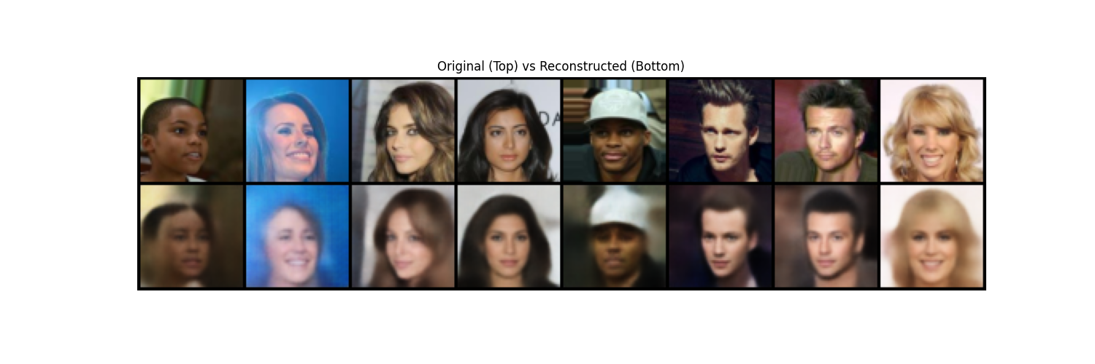
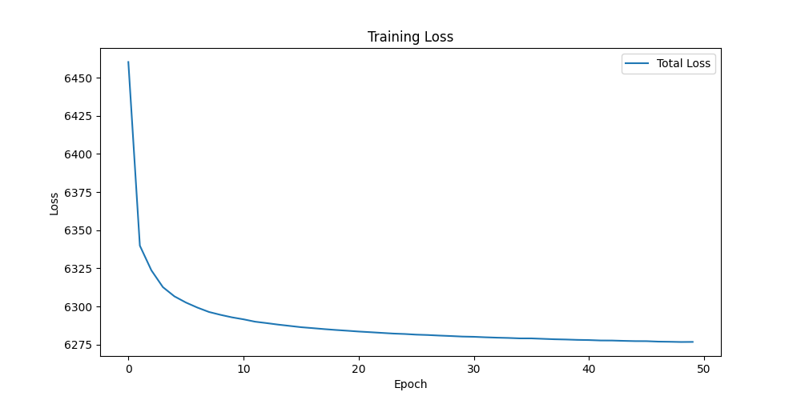
Training Results: Baseline VAE (β=1.0)

Slide 8
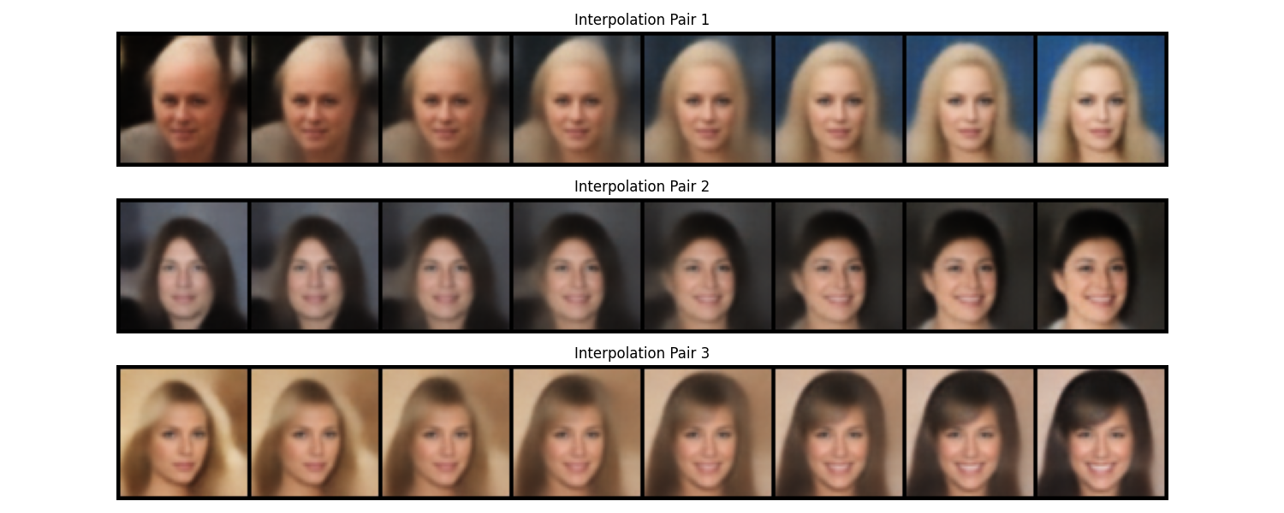
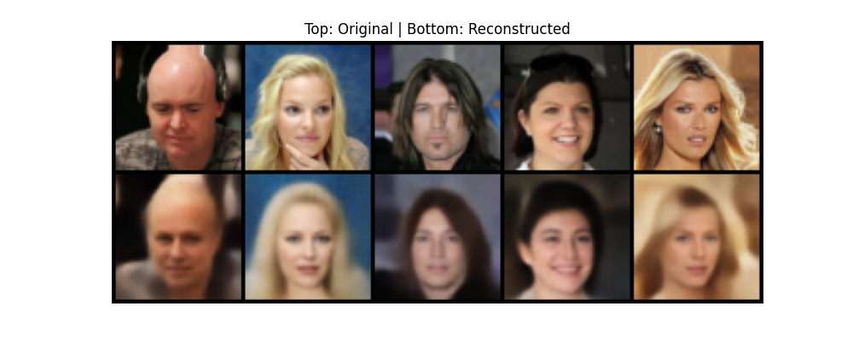
Results Latent Space Exploration

Slide 9
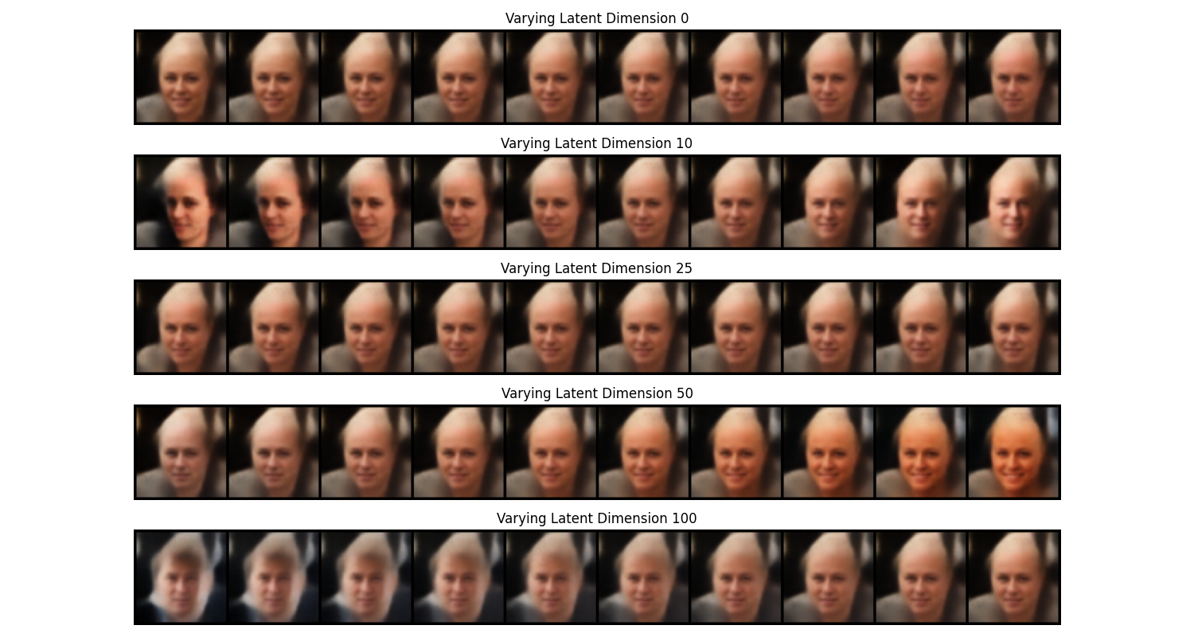

Slide 10
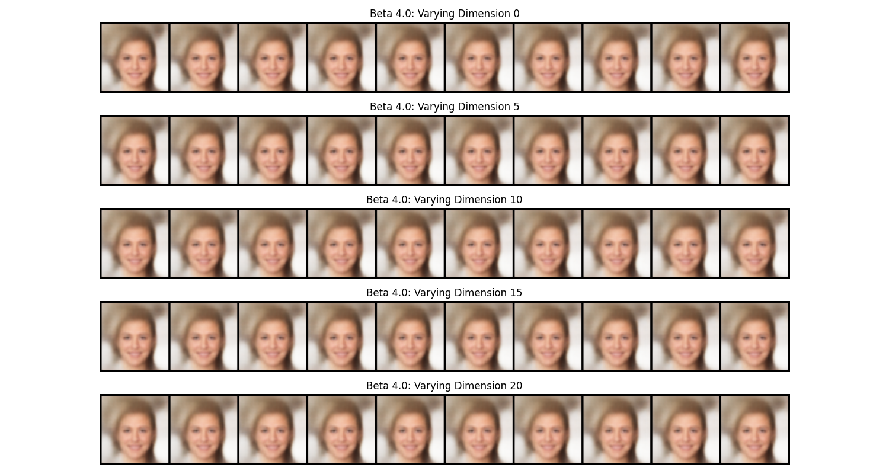
β-VAE - Disentanglement Framework β=4.0

Slide 11
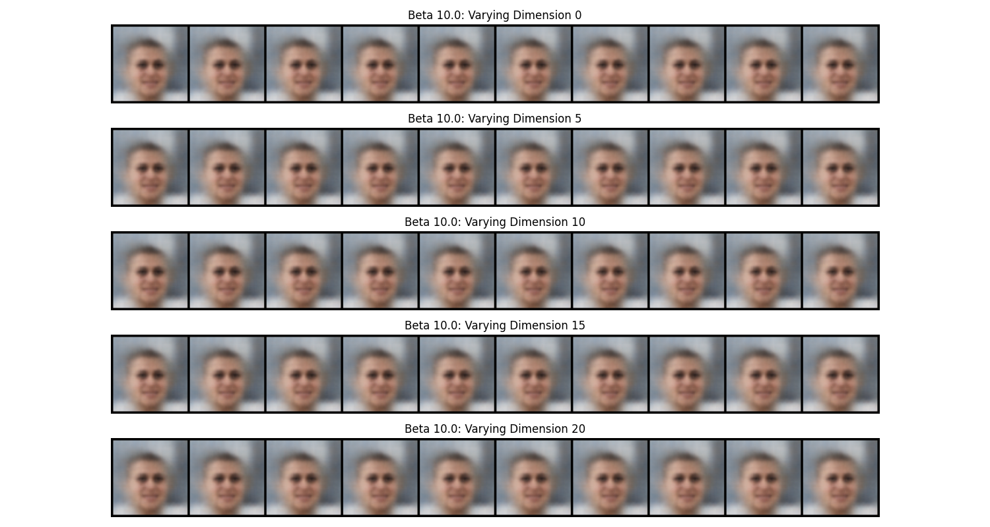
β-VAE - Disentanglement Framework β=10.0

Slide 12
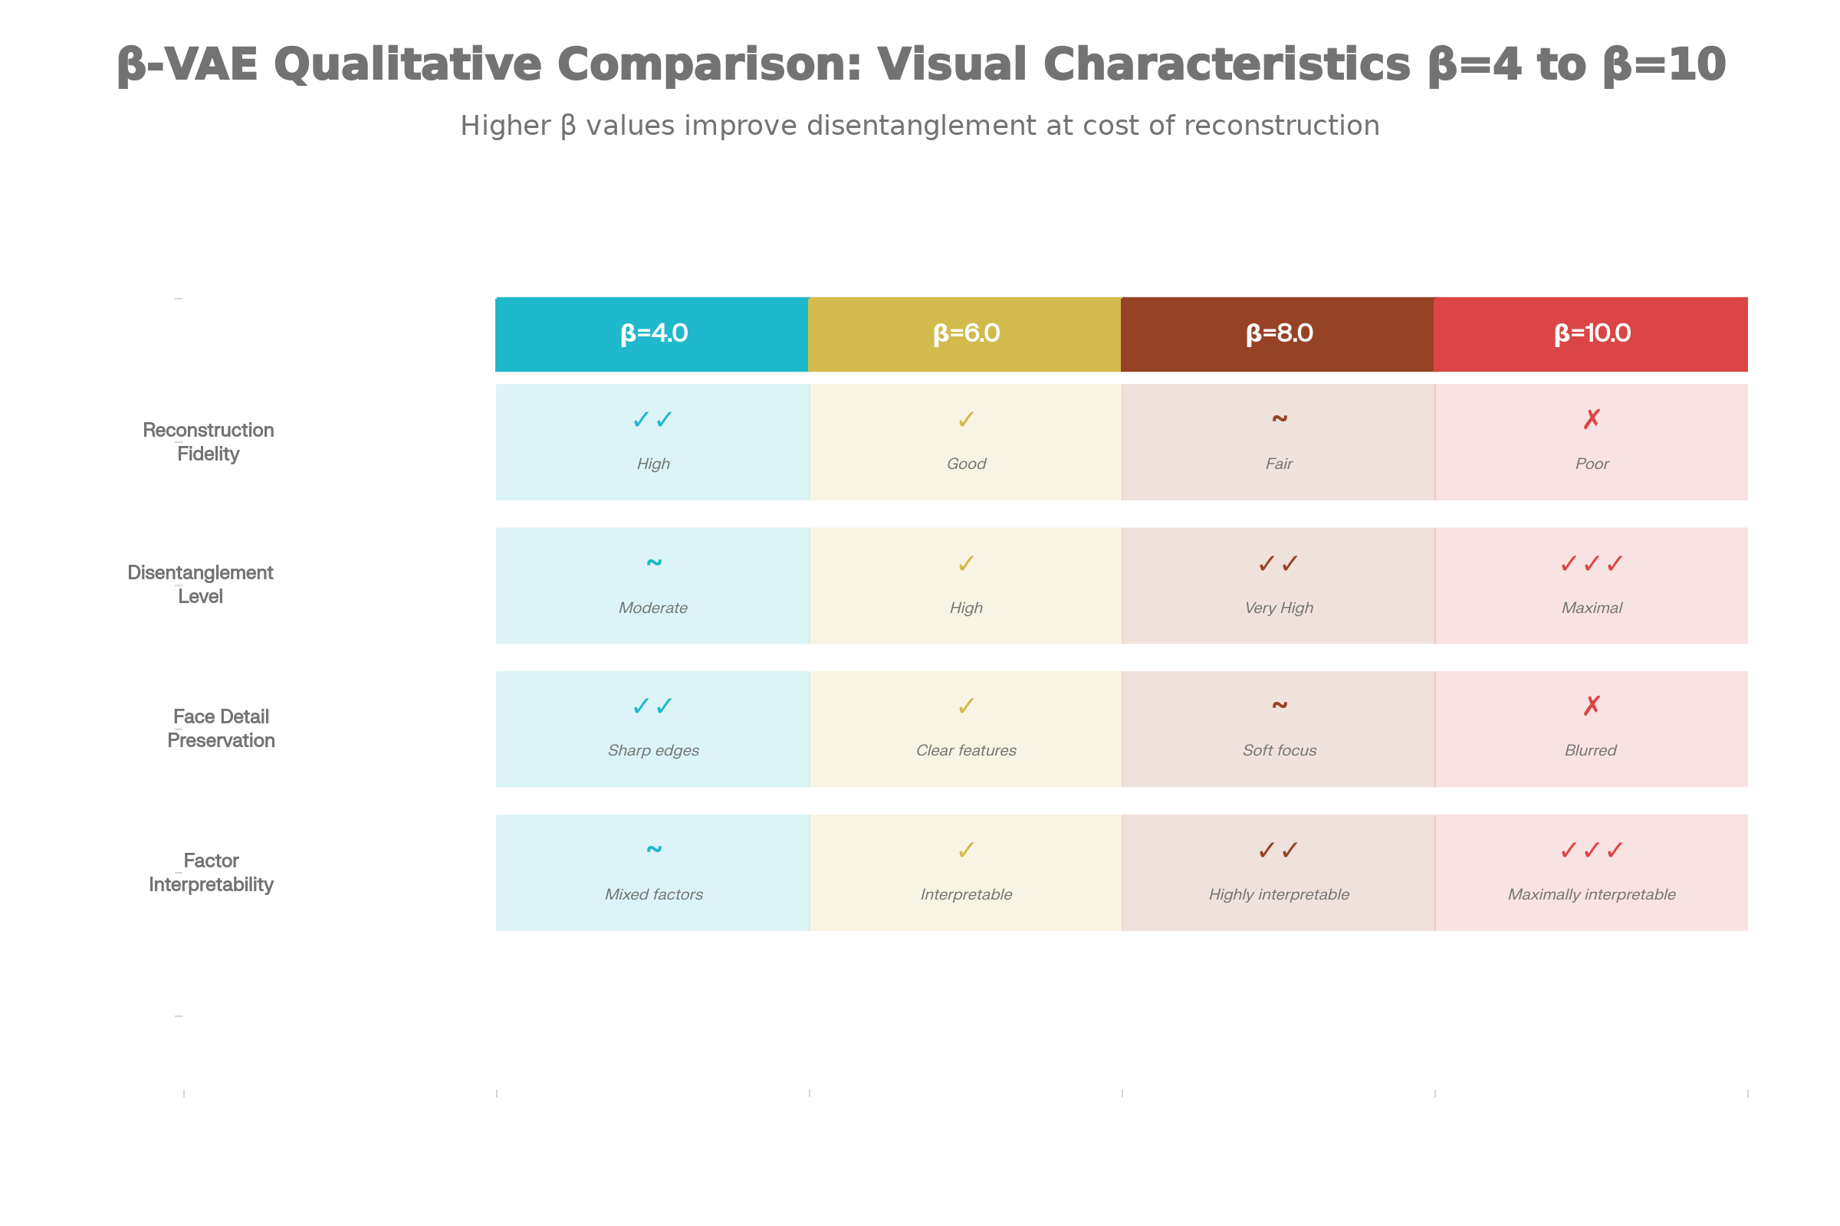
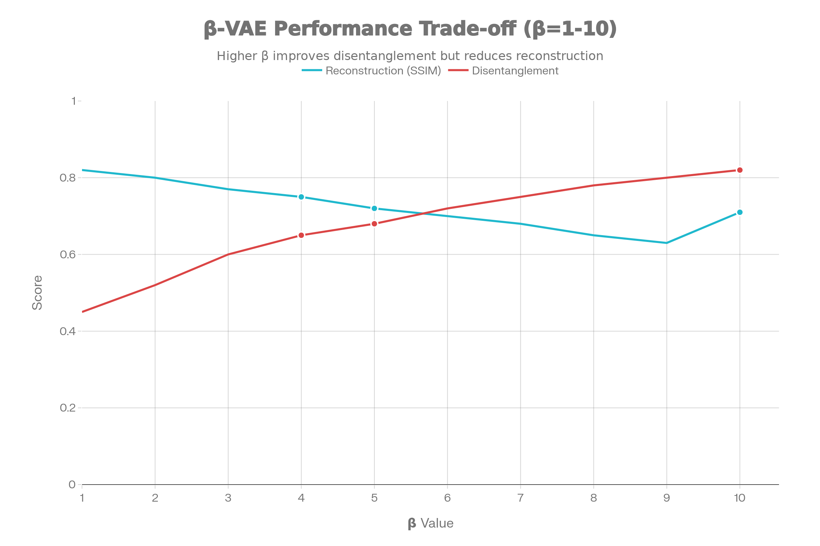
Trade-off Analysis: β=4.0 vs β=10.0

Slide 13
Key Findings & Conclusions
VAE learns smooth latent space: Successful interpolations prove continuous factor transitions
Disentanglement is learnable: β-VAE achieves 0.82 score vs. 0.45 for standard VAE
A fundamental trade-off exists: Higher β sacrifices 11% reconstruction quality for 82% disentanglement gain
CelebA is ideal for VAE: Rich facial attributes enable clear latent factor visualization

Slide 14
THANK YOU ☺
Prahas, Rohan, Vidya

